Slide 1
AZ-700T00A Module 01: Introduction to Azure Virtual Networks

Slide 2
Module Overview
Lesson 01: Explore Azure Virtual Networks
Lesson 06: Enable Cross-VNet connectivity with peering
Lesson 02: Configure Public IP services
Lesson 07: Exercise: connect two Azure Virtual Networks using global virtual network peering
Lesson 03: Exercise: design and implement a Virtual Network in Azure
Lesson 08: Implement virtual network traffic routing
Lesson 04: Design name resolution for your Virtual Network
Lesson 09: Configure internet access with Azure Virtual NAT
Lesson 05: Exercise: configure DNS settings in Azure
Review

Slide 3
Lesson 01: Explore Azure Virtual Networks

Slide 4
Explore Azure Virtual Networks overview
Capabilities of Azure Virtual Networks
Virtual Network Address space
Subnets
Private IP Address allocation
Understand Regions and Subscriptions
Create a Virtual Network
Demonstration – Creating Virtual Networks
Review

Slide 5
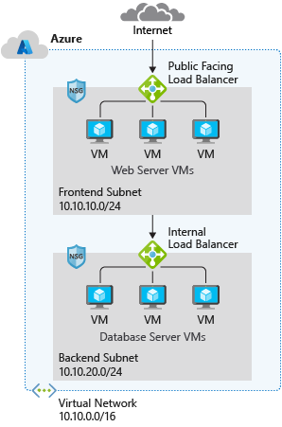
Capabilities of Azure Virtual Networks
Communication with the Internet
Communication between Azure resources
Communication between on-premises resources
Filtering network traffic
Routing network traffic
Notes:
Capabilities of Azure Virtual Networks
Azure VNet enables resources in Azure resources to securely communicate with each other, the internet, and on-premises networks.
Communication with the internet. All resources in a VNet can communicate outbound to the internet, by default. You can communicate inbound to a resource by assigning a public IP address or a public Load Balancer. You can also use public IP or public Load Balancer to manage your outbound connections.
Communication between Azure resources. There are three key mechanisms through which Azure resource can communicate: VNets, VNet service endpoints and VNet peering. Virtual Networks can connect not only VMs, but other Azure Resources, such as the App Service Environment, Azure Kubernetes Service, and Azure VM Scale sets. You can use service endpoints to connect to other Azure resource types, such as Azure SQL databases and storage accounts. When you create a VNet, your services and VMs within your VNet can communication directly and securely with each other in the cloud.
Communication between on-premises resources. Securely extend your data center. You can connect your on-premises computers and networks to a virtual network using any of the following options: Point-to-site virtual private network (VPN), Site-to-site VPN, Azure ExpressRoute.
Filtering network traffic. You can filter network traffic between subnets using any combination of network security groups and network virtual appliances like firewalls, gateways, proxies, and Network Address Translation (NAT) services.
Routing network traffic. Azure routes traffic between subnets, connected virtual networks, on-premises networks, and the Internet, by default. You can implement route tables or border gateway protocol (BGP) routes to override the default routes Azure creates.

Slide 6
Virtual Network address space
RFC 1918
10.0.0.0 - 10.255.255.255 (10/8 prefix)
172.16.0.0 - 172.31.255.255 (172.16/12 prefix)
192.168.0.0 - 192.168.255.255 (192.168/16 prefix)
Azure reserves 5 IP addresses
x.x.x.0: Network address
x.x.x.1: Reserved by Azure for the default gateway
x.x.x.2, x.x.x.3: Reserved by Azure to map the Azure DNS IPs to the VNet space
x.x.x.255: Network broadcast address
Unavailable address ranges:
224.0.0.0/4 (Multicast)
255.255.255.255/32 (Broadcast)
127.0.0.0/8 (Loopback)
169.254.0.0/16 (Link-local)
168.63.129.16/32 (Internal DNS)
Logical representation of your own network
Create a dedicated private cloud-only virtual network
Securely extend your datacenter with virtual networks
Enable hybrid cloud scenarios
Notes:
Azure Virtual Networks - https://azure.microsoft.com/services/virtual-network/
What is Azure Virtual Network? - https://docs.microsoft.com/azure/virtual-network/virtual-networks-overview
Address space: When creating a VNet, you must specify a custom private IP address space using public and private (RFC 1918) addresses. Azure assigns resources in a virtual network a private IP address from the address space that you assign. For example, if you deploy a VM in a VNet with address space, 10.0.0.0/16, the VM will be assigned a private IP like 10.0.0.4.

Slide 7
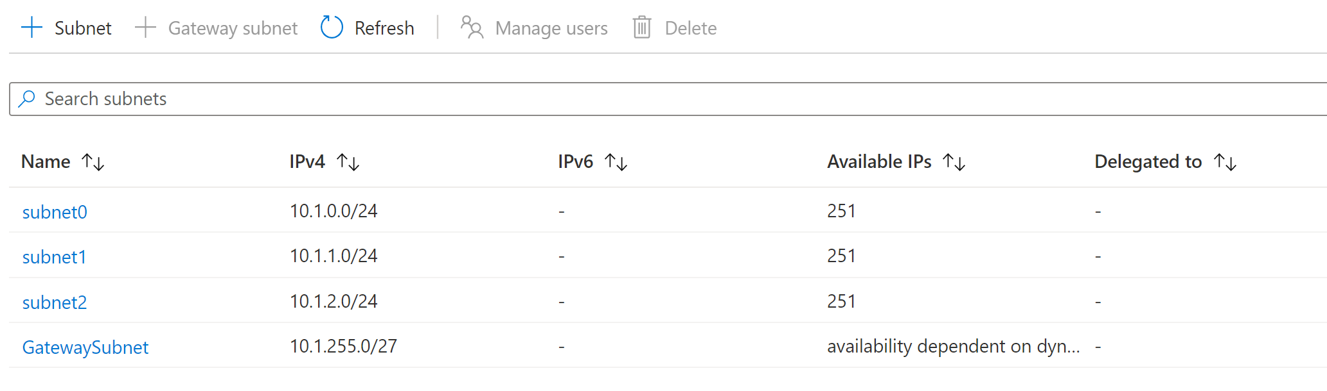
Subnets
A virtual network can be segmented into one or more subnets
Subnets provide logical divisions within your network
Subnets can help improve security, increase performance, and make it easier to manage the network
Each subnet must have a unique address range – cannot overlap with other subnets in the virtual network in the subscription
Notes:
✔️ Azure reserves 5 IP addresses within each subnet.
x.x.x.0: Network address
x.x.x.1: Reserved by Azure for the default gateway
x.x.x.2, x.x.x.3: Reserved by Azure to map the Azure DNS IPs to the VNet space
x.x.x.255: Network broadcast address
You can segment VNets into smaller subnets, creating as many subnets as you require within the subscription limit. You can then deploy Azure resources in a specific subnet. Just like in a traditional network, subnets allow you to segment your VNet address space into segments that are appropriate for the organization's internal network. This also improves address allocation efficiency. When planning to implement subnets, you need to consider the following:
Each subnet must have a unique address range, specified in Classless Inter-Domain Routing (CIDR) format.
Certain Azure services require their own subnet.
Subnets can be used for traffic management. For example, you can create subnets to route traffic through a network virtual appliance.
You can limit access to Azure resources to specific subnets with a virtual network service endpoint. You can create multiple subnets, and enable a service endpoint for some subnets, but not others.
You can secure resources within subnets using Network Security Groups.

Slide 8
Private IP Addresses allocation
Private IP Addresses | IP address association
Virtual Machine | NIC
Internal Load Balancer | Front-end configuration
Application Gateway | Front-end configuration
Dynamic (default). Azure assigns the next available unassigned or unreserved IP address in the subnet’s address range
Static. You select and assign any unassigned or unreserved IP address in the subnet's address range
Notes:
Private IP addresses - https://docs.microsoft.com/azure/virtual-network/private-ip-addresses

Slide 9
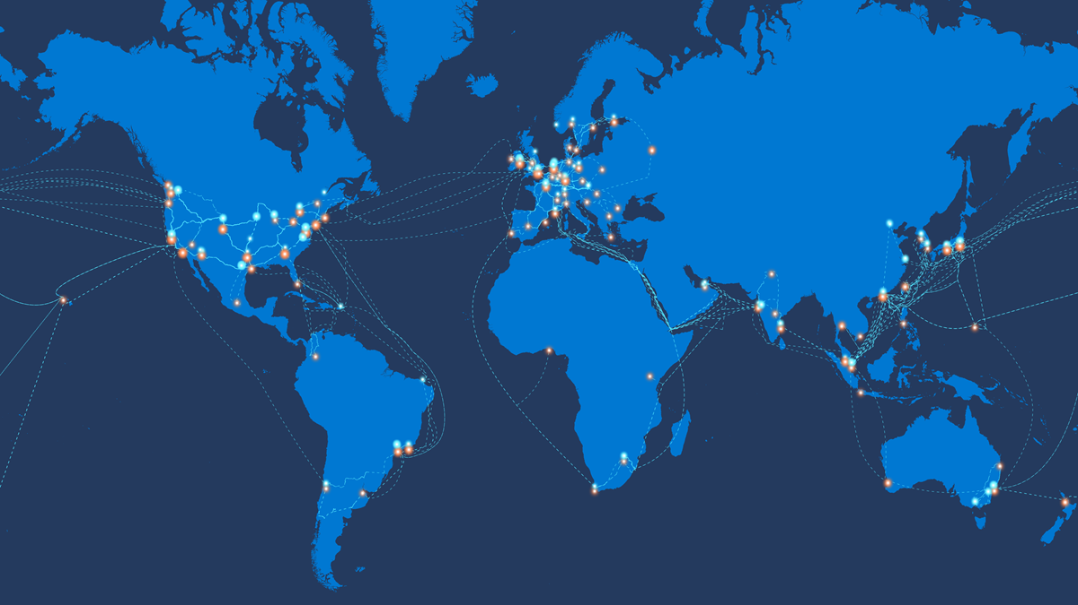
Understand Regions and Subscriptions
Regions: VNet is scoped to a single region/location; however, multiple virtual networks from different regions can be connected using Virtual Network Peering.
Notes:
https://docs.microsoft.com/azure/networking/microsoft-global-network
https://docs.microsoft.com/azure/virtual-network/virtual-network-vnet-plan-design-arm#connectivity
All Azure resources are created in an Azure region and subscription. A resource can only be created in a virtual network that exists in the same region and subscription as the resource. You can however, connect virtual networks that exist in different subscriptions and regions. When deciding which region(s) to deploy resources in, consider where consumers of the resources are physically located:
Consumers of resources typically want the lowest network latency to their resources. To determine relative latencies between a specified location and Azure regions, see View relative latencies.
https://docs.microsoft.com/azure/network-watcher/view-relative-latencies?toc=/azure/virtual-network/toc.json
Do you have data residency, sovereignty, compliance, or resiliency requirements? If so, choosing the region that aligns to the requirements is critical. For more information, see Azure geographies.
https://azure.microsoft.com/global-infrastructure/geographies/
Do you require resiliency across Azure Availability Zones within the same Azure region for the resources you deploy? You can deploy resources, such as virtual machines (VM) to different availability zones within the same virtual network. Not all Azure regions support availability zones however. To learn more about availability zones and the regions that support them, see Availability zones.
https://docs.microsoft.com/azure/availability-zones/az-overview?toc=/azure/virtual-network/toc.json
Regional/global presence
Azure datacenters exist in many regions worldwide. When selecting multiple Azure datacenters, consider two related factors: geographical distances and latency. To optimize user experience, evaluate the distance between each virtual datacenter as well as the distance from each virtual datacenter to the end users.
An Azure region that hosts your virtual datacenter must conform with regulatory requirements of any legal jurisdiction under which your organization operates.

Slide 10
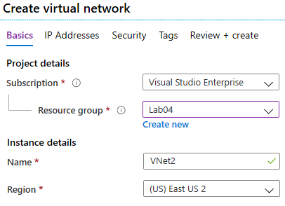
Create a Virtual Network
Create new virtual networks at any time
Add virtual networks when you create a virtual machine
Need to define the address space, and at least one subnet
Ensure non-overlapping address spaces
Notes:
QuickStart: Create a virtual network using the Azure portal - https://docs.microsoft.com/azure/virtual-network/quick-create-portal
✔️ Always plan to use an address space that is not already in use in your organization, either on-premises or in other VNets. Even if you plan for a VNet to be cloud-only, you may want to make a VPN connection to it later. If there is any overlap in address spaces at that point, you will have to reconfigure or recreate the VNet. The next lesson will focus on IP addressing.
Best practices
As you build your network in Azure, it is important to keep in mind the following universal design principles:
Ensure non-overlapping address spaces. Make sure your VNet address space (CIDR block) does not overlap with your organization's other network ranges.
Your subnets should not cover the entire address space of the VNet. Plan ahead and reserve some address space for the future.
It is recommended you have fewer large VNets rather than multiple small VNets. This will prevent management overhead. ( 5 IP address not usable per subnet due to Azure reserving them)
Secure your VNet's by assigning Network Security Groups (NSGs) to the subnets beneath them.

Slide 11
Demonstration – Creating Virtual Networks
Create a virtual network in the portal
Create a virtual network with PowerShell
Notes:
Consider showing students how to create a Virtual network in the Azure portal or PowerShell – consider their next exercise

Slide 12
Explore Azure Virtual Networks - Review
Knowledge Check
Microsoft Learn Modules (docs.microsoft.com/Learn)
Azure Virtual Network Documentation
Azure Virtual Network | Microsoft Docs
Notes:
Learn - https://docs.microsoft.com/learn/browse/

Slide 13
Lesson 02: Configure Public IP services

Slide 14
Configure public IP services overview
Public IP Addresses
Choose the appropriate SKU for a public IP
Creating Public IP Addresses
Review

Slide 15
Public IP Addresses
Public IP addresses | IP address association | Dynamic | Static
Virtual Machine | NIC | Yes | Yes
Load Balancer | Front-end configuration | Yes | Yes
VPN Gateway | Gateway IP configuration | Yes (non-AZ only) | Yes
Application Gateway | Front-end configuration | Yes (V1 only) | Yes (V2 only)
Azure Firewall | Front-end configuration | No | Yes
NAT gateway | Gateway IP configuration | No | Yes
A public IP address resource can be associated with resources such as virtual machine network interfaces, internet-facing load balancers, VPN gateways, and Application Gateways
Notes:
Public IP addresses - https://docs.microsoft.com/azure/virtual-network/public-ip-addresses
In Azure Resource Manager, a public IP address is a resource that has its own properties. Some of the resources you can associate a public IP address resource with:
Virtual machine network interfaces
Virtual machine scale sets
Public Load Balancers
Virtual Network Gateways (VPN/ER)
NAT gateways
Application Gateways
Azure Firewall
Bastion Host
Route Server
For the full chart of resources see here: Public IP addresses in Azure - Azure Virtual Network | Microsoft Docs https://docs.microsoft.com/azure/virtual-network/ip-services/public-ip-addresses#at-a-glance
Public IP addresses are created with an IPv4 or IPv6 address, which can be either static or dynamic.
A dynamic public IP address is an assigned address that can change over the lifespan of the Azure resource. The dynamic IP address is allocated when you create or start a VM. The IP address is released when you stop or delete the VM. In each Azure region, public IP addresses are assigned from a unique pool of addresses. The default allocation method is dynamic.
A static public IP address is an assigned address that will not change over the lifespan of the Azure resource. To ensure that the IP address for the resource remains the same, set the allocation method explicitly to static. In this case, an IP address is assigned immediately. It is released only when you delete the public IP resource or change the IP allocation method to dynamic.

Slide 16
Choose the appropriate SKU for a public IP
Basic SKU
Assigned with the static or dynamic allocation method
Open by default. NSGs are recommended but optional
Assigned to network interfaces, VPN gateway, public load balancers, or Application Gateways
Don’t support availability zone scenarios
Standard SKU
Always use static allocation method
Secure by default and closed to inbound traffic
Allow inbound traffic with NSG
Assigned to network interfaces, standard public load balancers, or Application Gateways
Can be zone-redundant, zonal, or no-zone
Notes:
For public IP addresses, there are two types of SKUs to choose from: Basic and Standard. All public IP addresses created before the introduction of SKUs are Basic SKU public IP addresses. With the introduction of SKUs, you have the option to specify which SKU you would like the public IP address to be.
SKU. Basic SKU IPv4 addresses can be upgraded after creation to Standard SKU.. A standalone virtual machine, virtual machines within an availability set, or virtual machine scale sets can use Basic or Standard SKUs. Mixing SKUs between virtual machines within availability sets or scale sets or standalone VMs is not allowed.
Basic SKU
Basic SKU public IPs can be assigned by using static or dynamic allocation methods. Basic IPs are open by default, so the use of Network security groups is recommended but optional for restricting inbound or outbound traffic.
Basic public IPs can be assigned to any Azure resource that can be assigned a public IP address, such as network interfaces, VPN gateways, application gateways, and internet-facing load balancers. They do not support availability zone scenarios. You must use a Standard SKU public IP for an availability zone scenario.
Standard SKU
Standard SKU public IP addresses always use the static allocation method. Standard IPs are secure by default and closed to inbound traffic. You must explicitly allow inbound traffic by using a network security group.
Standard IPs can be assigned to network interfaces, Standard public load balancers, application gateways, or VPN gateways. Standard IPs are zone-redundant by default and optionally zonal (they can be created zonal and guaranteed in a specific availability zone).

Slide 17
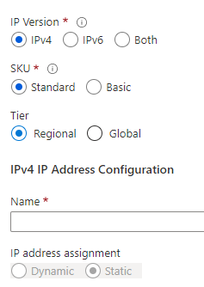
Creating Public IP Addresses
Available in IPv4 or IPv6 or both
Basic vs Standard SKU
Regional vs Global
Dynamic vs Static
Range of contiguous addresses available as a prefix
Notes:
Create, change, or delete IP addresses - https://docs.microsoft.com/azure/virtual-network/virtual-network-public-ip-address
The Global Tier allows a public IP address to be used with cross-region load balancers.
Consider showing this in the Azure portal

Slide 18
Configure Public IP services - Review
Knowledge Check
Microsoft Learn Modules (docs.microsoft.com/Learn)
Public IP addresses in Azure - Azure Virtual Network | Microsoft Docs
Notes:
Learn - https://docs.microsoft.com/learn/browse/

Slide 19
Lesson 03: Exercise: design and implement a Virtual Network in Azure

Slide 20
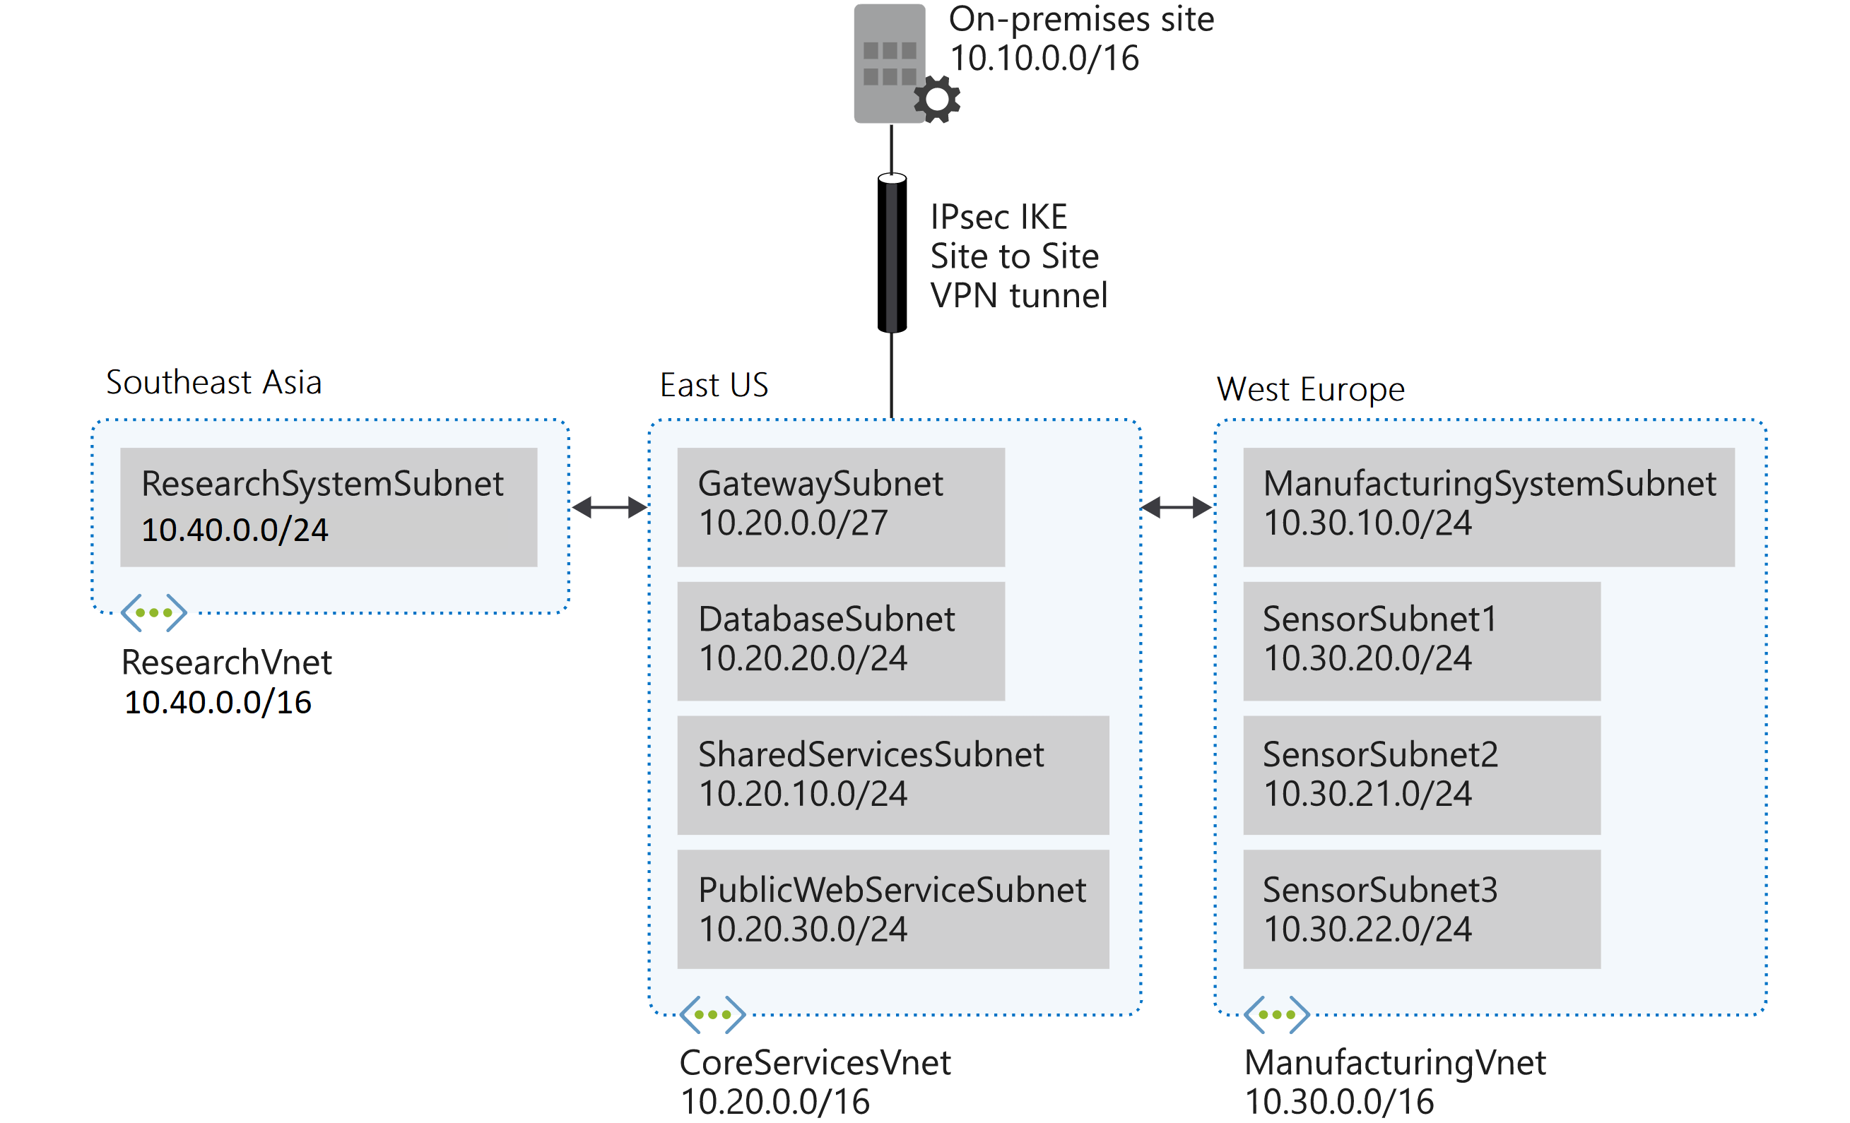
Design and implement a Virtual Network in Azure
Task 1: Create the Contoso resource group
Task 2: Create the CoreServicesVnet virtual network and subnets
Task 3: Create the ManufacturingVnet virtual network and subnets
Task 4: Create the ResearchVnet virtual network and subnets
Task 5: Verify the creation of VNets and Subnets
Notes:
Design and implement IP addressing for Azure virtual networks
in this exercise you will deploy an azure virtual network and configure the subnets
AZ-700-Designing-and-Implementing-Microsoft-Azure-Networking-Solutions/4-exercise-design-implement-virtual-network-azure.md at master · MicrosoftLearning/AZ-700-Designing-and-Implementing-Microsoft-Azure-Networking-Solutions (github.com)
https://microsoftlearning.github.io/AZ-700-Designing-and-Implementing-Microsoft-Azure-Networking-Solutions/Instructions/Exercises/M01-Unit%204%20Design%20and%20implement%20a%20Virtual%20Network%20in%20Azure.html

Slide 21
Summary – Exercise: design and implement a Virtual Network in Azure
Check your knowledge
Microsoft Learn Modules (docs.microsoft.com/Learn)
Quickstart: Create a virtual network - Azure portal - Azure Virtual Network | Microsoft Docs
Create a virtual network - quickstart - Azure PowerShell | Microsoft Docs

Slide 22
Lesson 04: Design Name Resolution for Azure Virtual Network

Slide 23
Design Name Resolution for Azure Virtual Network overview
Public DNS
DNS for Private Domains
Azure DNS Zones
Private Zones Scenarios
DNS Delegation
Significance of IP address 168.63.129.16
DNS Record Sets
Demonstration
Review
Notes:
Configure and manage virtual networking (25-30%)
Implement and manage virtual networking
* Configure Azure DNS, including custom DNS settings and private or public DNS zones.

Slide 24
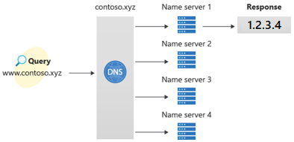
Public DNS
Public DNS services resolve names and IP addresses for resources and services accessible over the internet such as web servers. Azure DNS is a hosting service for DNS domain that provides name resolution by using Microsoft Azure infrastructure
In Azure DNS, you can create address records manually within relevant zones. The records most frequently used will be:
• Host records: A/AAAA (IPv4/IPv6)
• Alias records: CNAME
Notes:
The Domain Name System (DNS) is a hierarchical and decentralized naming system for computers, services, or other resources connected to the Internet or a private network. It associates various information with domain names assigned to each of the participating entities. Most prominently, it translates more readily memorized domain names to the numerical IP addresses needed for locating and identifying computer services and devices with the underlying network protocols.
What is Azure DNS? | Microsoft Docs
https://docs.microsoft.com/azure/dns/dns-overview
Public DNS services resolve names and IP addresses for resources and services accessible over the internet such as web servers.
In Azure DNS, you can create address records manually within relevant zones. The records most frequently used will be:
Host records: A/AAAA (IPv4/IPv6)
Alias records: CNAME

Slide 25
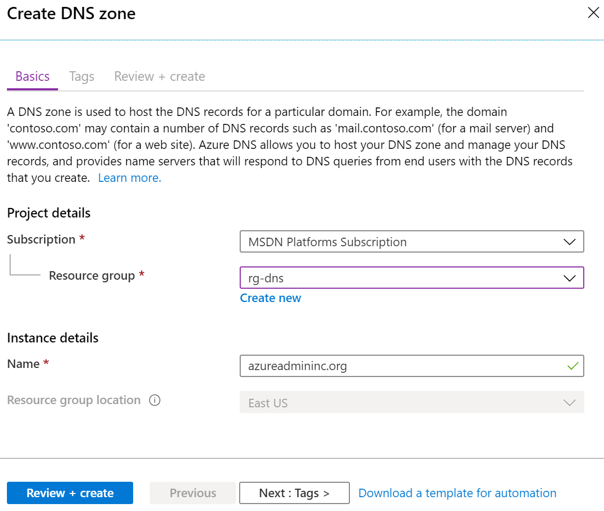
Azure DNS Zones
A DNS zone hosts the DNS records for a domain
The same zone name can be reused in a different resource group or a different Azure subscription
Where multiple zones share the same name, each instance is assigned different name server addresses
Root/Parent domain is registered at the registrar and pointed to Azure NS
Notes:
DNS Zones - https://docs.microsoft.com/azure/dns/dns-zones-records#dns-zones
You do not have to own a domain name to create a DNS zone with that domain name in Azure DNS. However, you do need to own the domain to configure the domain.

Slide 26
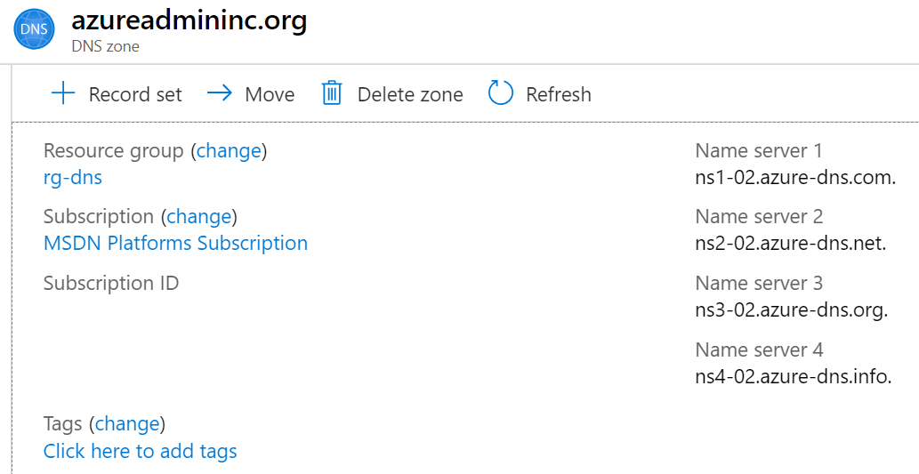
DNS Delegation
When delegating a domain to Azure DNS, you must use the name server names provided by Azure DNS – use all four
Once the DNS zone is created, update the parent registrar
For child zones, register the NS records in the parent domain
Notes:
https://docs.microsoft.com/azure/dns/dns-domain-delegation
Host your domain on Azure DNS - https://docs.microsoft.com/learn/modules/host-domain-azure-dns/
You can't use Azure DNS to buy a domain name. For an annual fee, you can buy a domain name by using App Service domains or a third-party domain name registrar. Your domains then can be hosted in Azure DNS for record management. For more information, see Delegate a domain to Azure DNS. https://docs.microsoft.com/azure/dns/dns-delegate-domain-azure-dns

Slide 27
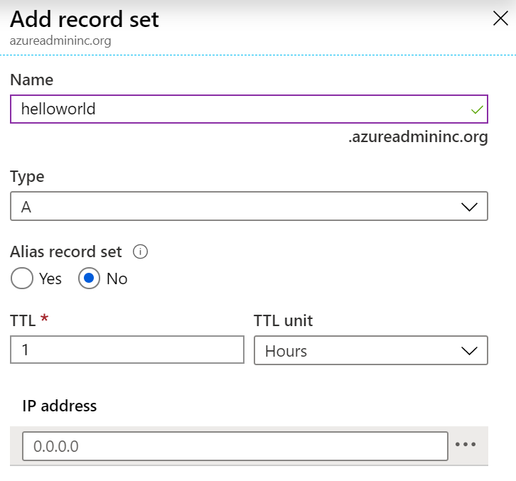
DNS Record Sets
A record set is a collection of records in a zone that have the same name and are the same type
Azure DNS supports all common DNS record types: A, AAAA, CAA, CNAME, MX, NS, PTR, SOA, SRV, and TXT
A record set cannot contain two identical records
Changing the drop-down Type, changes the information required
Notes:
You can add up to 20 records to any record set
DNS Zones and Records overview - Azure DNS | Microsoft Docs
https://docs.microsoft.com/azure/dns/dns-zones-records

Slide 28
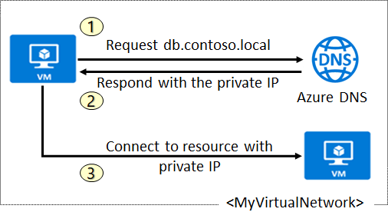
DNS for Private Domains
Use your own custom domain names
Provides name resolution for VMs within a VNet and between VNets
db.contoso.lab
Automatic hostname record management
Removes the need for custom DNS solutions
Use all common DNS records types
Available in all Azure regions
Notes:
Private DNS services resolve names and IP addresses for resources and services accessible over the internet such as web servers.
Private DNS zones in Azure are available to internal resources only. They are global in scope, so you can access them from any region, any subscription, any VNet, and any tenant. If you have permission to read the zone, you can use it for name resolution. Private DNS zones are highly resilient, being replicated to regions all throughout the world. They are not available to resources on the internet.
https://docs.microsoft.com/azure/dns/private-dns-overview#benefits
QuickStart: Create an Azure private DNS zone using the Azure portal - https://docs.microsoft.com/azure/dns/private-dns-getstarted-portal

Slide 29
Private Zone Scenarios
Query:VM2.contoso.lab
Response:VM1.contoso.lab
DNS queries across the linked virtual networks are resolved
DNS resolution in VNet1 is private and not accessible from the Internet

Slide 30
Significance of IP address 168.63.129.16
Enables the VM Agent to communicate with the Azure platform to signal that it is in a "Ready" state
Enables communication with the DNS virtual server to provide filtered name resolution to the resources (such as VM) that do not have a custom DNS server.
Enables health probes from Azure load balancer to determine the health state of VMs
Enables the VM to obtain a dynamic IP address from the DHCP service in Azure
Enables Guest Agent heartbeat messages for the PaaS role
Notes:
This IP is not accessible from on prem networks
IP address 168.63.129.16 is a virtual public IP address that is used to facilitate a communication channel to Azure platform resources. Customers can define any address space for their private virtual network in Azure. The Azure platform resources must be presented as a unique public IP address. This virtual public IP address facilitates the following things:
Enables the VM Agent to communicate with the Azure platform to signal that it is in a "Ready" state
Enables communication with the DNS virtual server to provide filtered name resolution to the resources (such as VM) that do not have a custom DNS server. This filtering makes sure that customers can resolve only the hostnames of their resources
Enables health probes from Azure load balancer to determine the health state of VMs
Enables the VM to obtain a dynamic IP address from the DHCP service in Azure
Enables Guest Agent heartbeat messages for the PaaS role
In a non-virtual network scenario (Classic), a private IP address is used instead of 168.63.129.16. This private IP address is dynamically discovered through DHCP. Firewall rules specific to 168.63.129.16 need to be adjusted as appropriate.

Slide 31
Demonstration – DNS Name Resolution
Create a DNS zone
Add a DNS record set
Use PowerShell to view DNS information
View your name servers
Test the resolution
Explore DNS metrics
Notes:
✔ Always consider having students walk-through the demonstrations themselves. Also, consider the overlap with the formal labs and your best use of time.
In this demonstration, you will explore Azure DNS.
Note: There is a DNS lab for the student.
Create a DNS zone
Access the Azure Portal.
Search for the DNS zones service.
On the Create DNS zone blade enter the following values, and Create the new DNS zone.
Name: contoso.internal.com
Subscription: <your subscription>
Resource group: Select or create a resource group
Location: Select your Location
Wait for the DNS zone to be created.
You may need to Refresh the page.
Add a DNS record set
Select +Record Set.
Use the Type drop-down to view the different types of records.
Notice how the required information changes as you change record types.
Change the Type to A and enter these values.
Name: ARecord
IP Address: 1.2.3.4
Notice you can add other records.
Select OK to save your record.
Refresh the page to observe the new record set.
You will need the resource group name.
Optional - Use PowerShell to view DNS information
Open the Cloud Shell.
Get information about your DNS zones. Notice the name servers and number of record sets.
Get-AzDnsZone -Name "contoso.internal.com" -ResourceGroupName <resourcegroupname>
Get information about your DNS record set.
Get-AzDnsRecordSet -ResourceGroupName <resourcegroupname> -ZoneName contoso.internal.com
View your name servers
Access the Azure Portal and your DNS zone.
Review the Name Server information. There should be four name servers.
Open the Cloud Shell.
Use PowerShell to confirm your NS records.
# Retrieve the zone information
$zone = Get-AzDnsZone –Name contoso.internal.com –ResourceGroupName <resourcegroupname>
# Retrieve the name server records
Get-AzDnsRecordSet –Name “@” –RecordType NS –Zone $zone
Test the resolution
Continue in the Cloud Shell.
Use a Name Server in your zone to review records.
nslookup arecord.contoso.internal.com <name server for the zone>
Nslookup should provide the IP address for the record.
Explore DNS metrics
Return to the Azure portal.
Select a DNS zone, and then select Metrics.
Use the Metrics drop-down to view the different metrics that are available.
Select Query Volume. If you have been using nslookup, there should be queries.
Use the Line Chart drop-down to observe other chart types, like Area Chart, Bar Chart, and Scatter Chart.
Note: For more information, Nslookup

Slide 32
Design Name Resolution for Azure Virtual Network - Review
Knowledge Check
Microsoft Learn Modules (docs.microsoft.com/Learn)
Host your domain on Azure DNS
Implement DNS for Windows Server IaaS VMs
Secure Windows Server DNS
Notes:
Learn - https://docs.microsoft.com/learn/browse/

Slide 33
Lesson 05: Exercise: configure DNS settings in Azure

Slide 34
Exercise – Configure DNS settings in Azure
Create a private DNS Zone
Link subnet for auto registration
Create Virtual Machines to test the configuration
Verify records are present in the DNS zone
Notes:
AZ-700-Designing-and-Implementing-Microsoft-Azure-Networking-Solutions/6-exercise-configure-dns-configuration-azure.md at master · MicrosoftLearning/AZ-700-Designing-and-Implementing-Microsoft-Azure-Networking-Solutions (github.com)
AZ-700-Designing-and-Implementing-Microsoft-Azure-Networking-Solutions (microsoftlearning.github.io)
https://microsoftlearning.github.io/AZ-700-Designing-and-Implementing-Microsoft-Azure-Networking-Solutions/Instructions/Exercises/M01-Unit%206%20Configure%20DNS%20settings%20in%20Azure.html

Slide 35
Lesson 06: Enable Cross-VNet Connectivity with Peering

Slide 36
Enable Cross-VNet Connectivity with Peering overview
VNet Peering
Gateway Transit and Connectivity
Service Chaining
Configure VNet Peering
Demonstration
Review
Notes:
Configure and manage virtual networking (25–30%)
Implement and manage virtual networking
* Create and configure virtual networks, including peering.

Slide 37
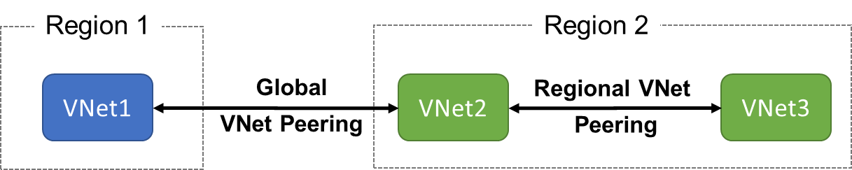
VNet Peering
VNet peering connects two Azure virtual networks
Two types of peering: Regional and Global
Peered networks use the Azure backbone for privacy and isolation
You can peer across subscriptions and tenants
VNet peering is not transitive
Notes:
Virtual network peering - https://docs.microsoft.com/azure/virtual-network/virtual-network-peering-overview
Not encrypted traffic
Egress traffic is billable

Slide 38
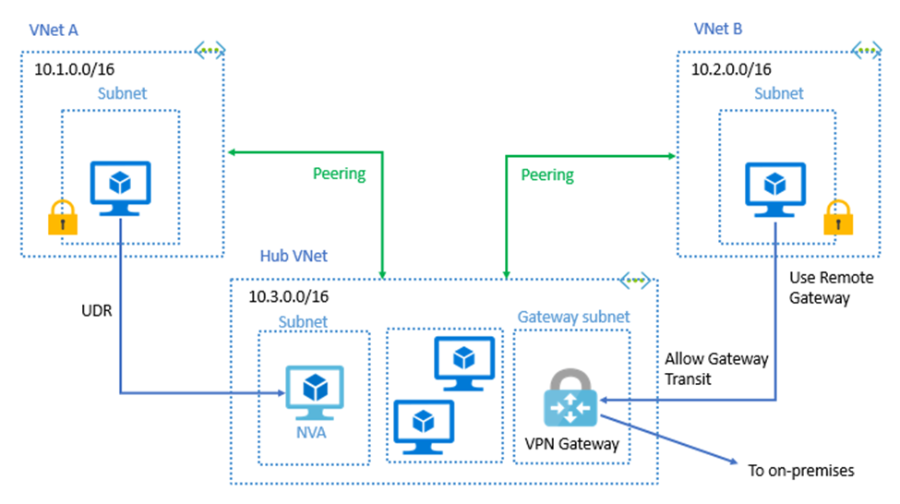

Implementing VNet Peering
Gateway transit allows peered virtual networks to share the gateway and get access to resources
No VPN gateway is required in the peered virtual network
Default VNet peering provides full connectivity
IP address spaces of connected networks can't overlap
Notes:
Azure Virtual Network frequently asked questions (FAQ) VNet Peering - https://docs.microsoft.com/azure/virtual-network/virtual-networks-faq

Slide 39
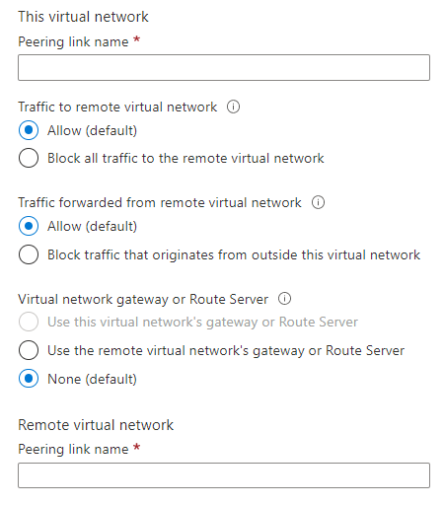
Configure VNet Peering
Allow virtual network access settings
Configure forwarded traffic settings
Notes:
Create, change, or delete a virtual network peering - https://docs.microsoft.com/azure/virtual-network/virtual-network-manage-peering#requirements-and-constraints
Tutorial: Connect virtual networks with virtual network peering using the Azure portal - https://docs.microsoft.com/azure/virtual-network/tutorial-connect-virtual-networks-portal
When you add a peering on one virtual network, the second virtual network configuration is automatically added as long as you do have the necessary permissions and it is not cross-tenant. Read more about permissions here: Create, change, or delete an Azure virtual network peering | Microsoft Docs https://docs.microsoft.com/en-/azure/virtual-network/virtual-network-manage-peering#permissions

Slide 40
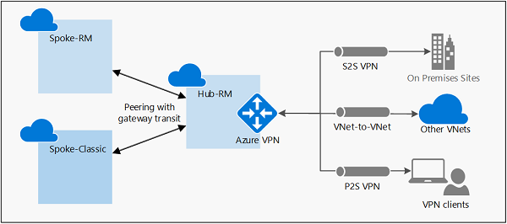
Configure VNet peering – Gateway Transit
Gateway transit allows spoke virtual networks to share the VPN gateway in the hub
Notes:
Configure VPN gateway transit for virtual network peering - Azure VPN Gateway | Microsoft Docs
https://docs.microsoft.com/azure/vpn-gateway/vpn-gateway-peering-gateway-transit
Gateway transit is a peering property that lets one virtual network use the VPN gateway in the peered virtual network for cross-premises or VNet-to-VNet connectivity.
The following diagram shows how gateway transit works with virtual network peering.
In the diagram, gateway transit allows the peered virtual networks to use the Azure VPN gateway in Hub-RM. Connectivity available on the VPN gateway, including S2S, P2S, and VNet-to-VNet connections, applies to all three virtual networks. The transit option is available for peering between the same, or different deployment models. If you are configuring transit between different deployment models, the hub virtual network and virtual network gateway must be in the Resource Manager deployment model, not the classic deployment model.

Slide 41
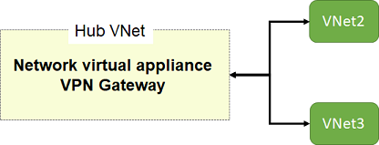
Service Chaining
Leverage user-defined routes and service chaining to implement custom routing
Implement a VNet hub with a network virtual appliance or a VPN gateway
Service chaining enables you to direct traffic from one virtual network to a virtual appliance, or virtual network gateway, in a peered virtual network, through user-defined routes
Notes:
Distribute your services across Azure virtual networks and integrate them by using virtual network peering - https://docs.microsoft.com/learn/modules/integrate-vnets-with-vnet-peering/
Distribute your services across Azure virtual networks and integrate them by using virtual network peering - Learn | Microsoft Docs
Service chaining enables you to direct traffic from one virtual network to a virtual appliance or gateway in a peered network through user-defined routes.
To enable service chaining, configure user-defined routes that point to virtual machines in peered virtual networks as the next hop IP address. User-defined routes could also point to virtual network gateways to enable service chaining.
You can deploy hub-and-spoke networks, where the hub virtual network hosts infrastructure components such as a network virtual appliance or VPN gateway. All the spoke virtual networks can then peer with the hub virtual network. Traffic flows through network virtual appliances or VPN gateways in the hub virtual network.
Virtual network peering enables the next hop in a user-defined route to be the IP address of a virtual machine in the peered virtual network, or a VPN gateway. You can't route between virtual networks with a user-defined route that specifies an Azure ExpressRoute gateway as the next hop type.
To learn more about user-defined routes, see User-defined routes overview. https://docs.microsoft.com/azure/virtual-network/virtual-networks-udr-overview#user-defined
To learn how to create a hub and spoke network topology, see Hub-spoke network topology in Azure. https://docs.microsoft.com/azure/architecture/reference-architectures/hybrid-networking/hub-spoke?tabs=portal

Slide 42
Demonstration – VNet Peering
Configure VNet peering on the first virtual network
Configure a VPN gateway
Allow gateway transit
Confirm VNet peering on the second virtual network
Notes:
✔ Always consider having students walk-through the demonstrations themselves. Also, consider the overlap with the formal labs and your best use of time.
Configure VNet Peering
Note: For this demonstration you will need two virtual networks.
Configure VNet peering on the first virtual network
In the Azure portal, select the first virtual network.
Under Settings, select Peerings.
Select + Add.
Provide a Peering link name for This virtual network peering. For example, VNet1toVNet2.
Provide a Peering link name for the Remote virtual network peering. For example, VNet2toVNet1.
In the Virtual network drop-down, select the Remote virtual network you would like to peer with ensuring you also select the correct Subscription.
Use the informational icons to review the Traffic to remote virtual network Traffic forwarded from remote virtual network, and Virtual network gateway or Route Server settings. If you do not have a VPN Gateway, those settings will be greyed out.
Select Add to save your settings.
On the Peerings page, discuss the Peering Status.
Confirm VNet peering on the second virtual network
In the Azure portal, select the second virtual network
Under Settings, select Peerings.
Notice that a peering has automatically been created. The name is what you provided when the first virtual network peering was configured.
Notice that the Peering Status is Connected.
Discuss how the settings could be changed.
Cancel your changes.

Slide 43
VNet Peering Review
Knowledge Check Questions
Microsoft Learn Modules (docs.microsoft.com/Learn)
Distribute your services across Azure virtual networks and integrate them by using virtual network peering
Notes:
Learn - https://docs.microsoft.com/learn/browse/

Slide 44
Lesson 07: Exercise: connect two Azure virtual networks using global VNet peering

Slide 45
Exercise: connect two Azure Virtual Networks using global VNet peering
Task 1: Create a Virtual Machine to test the configuration
Task 2: Connect to the Test VMs using RDP
Task 3: Test the connection between the VMs
Task 4: Create VNet peerings between CoreServicesVnet and ManufacturingVnet
Task 5: Test the connection between the VMs
Task 6: Clean up resources
Notes:
AZ-700-Designing-and-Implementing-Microsoft-Azure-Networking-Solutions (microsoftlearning.github.io)
https://microsoftlearning.github.io/AZ-700-Designing-and-Implementing-Microsoft-Azure-Networking-Solutions/Instructions/Exercises/M01-Unit%208%20Connect%20two%20Azure%20Virtual%20Networks%20using%20global%20virtual%20network%20peering.html

Slide 46
Lesson 08: Implement virtual network traffic routing

Slide 47
Implement virtual network traffic routing overview
Virtual network traffic routing
Configure User-defined routes (UDRs)
Configure forced tunneling
Configure Azure Route Server
Diagnose a routing problem
Demonstration
Review

Slide 48
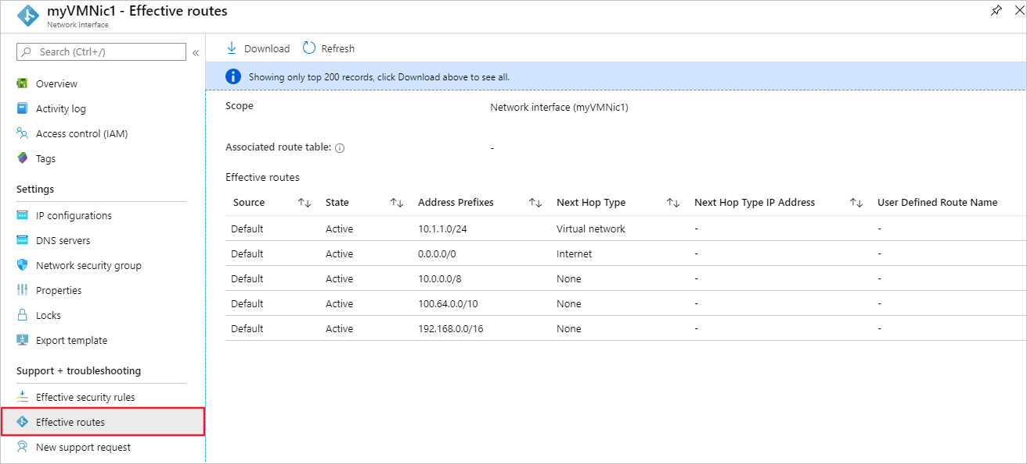
Virtual network traffic routing
System routes
Default routes
Custom routes
Notes:
Azure virtual network traffic routing | Microsoft Docs https://docs.microsoft.com/azure/virtual-network/virtual-networks-udr-overview
System routes
Azure automatically creates system routes and assigns the routes to each subnet in a virtual network. You can't create system or remove routes, but you can override some system routes with custom routes. Azure creates default system routes for each subnet, and adds additional optional default routes to specific subnets, or every subnet, when you use specific Azure capabilities.
Default routes
Each route contains an address prefix and next hop type. When traffic leaving a subnet is sent to an IP address within the address prefix of a route, the route that contains the prefix is the route Azure uses. Whenever a virtual network is created, Azure automatically creates the following default system routes for each subnet within the virtual network.
In routing terms, a hop is a waypoint on the overall route. Therefore, the next hop is the next waypoint that the traffic is directed to on its journey to its ultimate destination. The next hop types listed in the previous table represent how Azure routes traffic destined for the address prefix listed. The next hop types are defined as follows:
Virtual network: Routes traffic between address ranges within the address space of a virtual network. Azure creates a route with an address prefix that corresponds to each address range defined within the address space of a virtual network. Azure automatically routes traffic between subnets using the routes created for each address range.
Internet: Routes traffic specified by the address prefix to the Internet. The system default route specifies the 0.0.0.0/0 address prefix. Azure routes traffic for any address not specified by an address range within a virtual network to the Internet, unless the destination address is for an Azure service. Azure routes any traffic destined for its service directly to the service over the backbone network, rather than routing the traffic to the Internet. You can override Azure's default system route for the 0.0.0.0/0 address prefix with a custom route.
None: Traffic routed to the None next hop type is dropped, rather than routed outside the subnet. Azure automatically creates default routes for the following address prefixes:
10.0.0.0/8 and 192.168.0.0/16: Reserved for private use in RFC 1918.
100.64.0.0/10: Reserved in RFC 6598.
If you assign any of the previous address ranges within the address space of a virtual network, Azure automatically changes the next hop type for the route from None to Virtual network. If you assign an address range to the address space of a virtual network that includes, but isn't the same as, one of the four reserved address prefixes, Azure removes the route for the prefix and adds a route for the address prefix you added, with Virtual network as the next hop type.

Slide 49
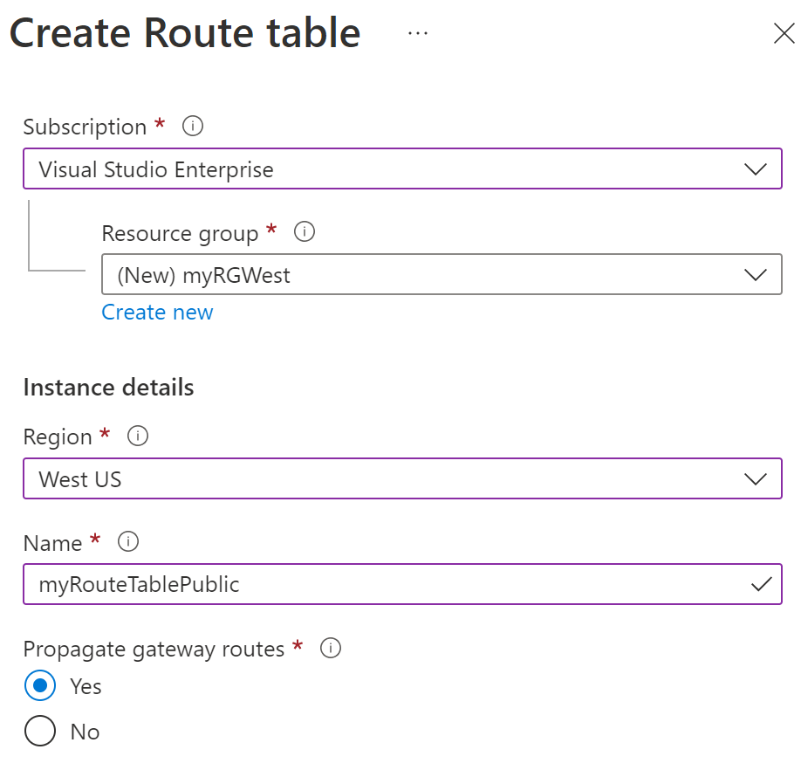
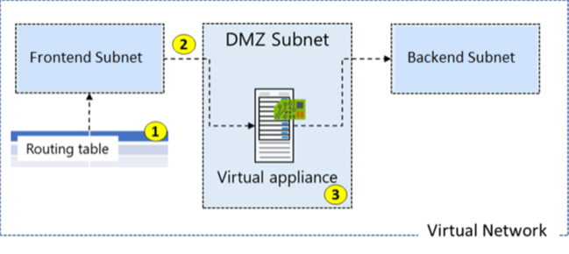
Configure User-defined routes
Notes:
design and implement user-defined routes (UDRs)
• associate a route table with a subnet
• configure forced tunneling
Here is an example where you have a virtual network that includes three subnets.
The subnets are Private, DMZ, and Public. In the DMZ subnet, there is a network virtual appliance (NVA). NVAs are VMs that help with network functions like routing and firewall optimization.
You want to ensure all traffic from the Public subnet goes through the NVA to the Private subnet.

Slide 50
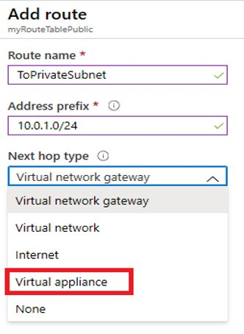
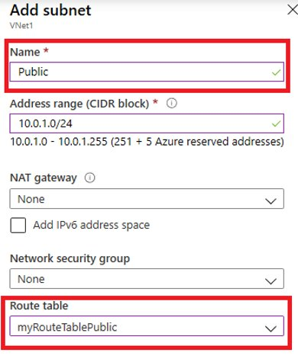
Create a Custom Route and associate route table to subnet
Notes:
The new route is named ToPrivateSubnet.
The Private subnet is at 10.0.1.0/24.
The route uses a virtual appliance. Notice the other choices for Next hop type: virtual network gateway, virtual network, internet, and none.
The virtual appliance is located at 10.0.2.4.

Slide 51
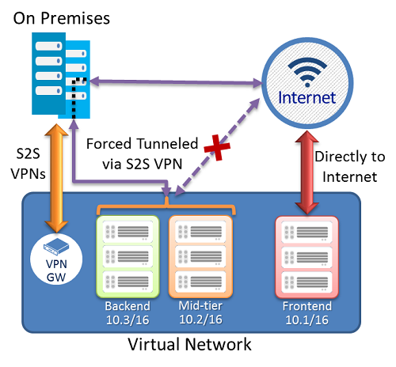
Configure forced tunneling
Each virtual network subnet has a built-in, system routing table. The system routing table has the following three groups of routes:
Local VNet routes: Route directly to the destination VMs in the same virtual network.
On-premises routes: Route to the Azure VPN gateway.
Default route: Route directly to the Internet. Packets destined to the private IP addresses not covered by the previous two routes are dropped.
To configure forced tunnelling, you must:
Create a routing table.
Add a user-defined default route to the VPN Gateway.
Associate the routing table to the appropriate VNet subnet(s).
Forced tunneling must be associated with a VNet that has a route-based VPN gateway.
You must set a default site connection among the cross-premises local sites connected to the virtual network.
The on-premises VPN device must be configured using 0.0.0.0/0 as traffic selectors.
Notes:
Forced tunneling lets you redirect or "force" all Internet-bound traffic back to your on-premises location via a Site-to-Site VPN tunnel for inspection and auditing. This is a critical security requirement for most enterprise IT policies. If you don't configure forced tunneling, Internet-bound traffic from your VMs in Azure always traverses from the Azure network infrastructure directly out to the Internet, without the option to allow you to inspect or audit the traffic. Unauthorized Internet access can potentially lead to information disclosure or other types of security breaches. Forced tunneling can be configured by using Azure PowerShell. It can't be configured using the Azure portal.
In the following example, the Frontend subnet is not force tunneled. The workloads in the Frontend subnet can continue to accept and respond to customer requests from the Internet directly. The Mid-tier and Backend subnets are forced tunneled. Any outbound connections from these two subnets to the Internet will be forced or redirected back to an on-premises site via one of the Site-to-site (S2S) VPN tunnels.
Each virtual network subnet has a built-in, system routing table. The system routing table has the following three groups of routes:
Local VNet routes: Route directly to the destination VMs in the same virtual network.
On-premises routes: Route to the Azure VPN gateway.
Default route: Route directly to the Internet. Packets destined to the private IP addresses not covered by the previous two routes are dropped.
To configure forced tunnelling, you must:
Create a routing table.
Add a user-defined default route to the VPN Gateway.
Associate the routing table to the appropriate VNet subnet(s).
Forced tunneling must be associated with a VNet that has a route-based VPN gateway.
You must set a default site connection among the cross-premises local sites connected to the virtual network.
The on-premises VPN device must be configured using 0.0.0.0/0 as traffic selectors.

Slide 52
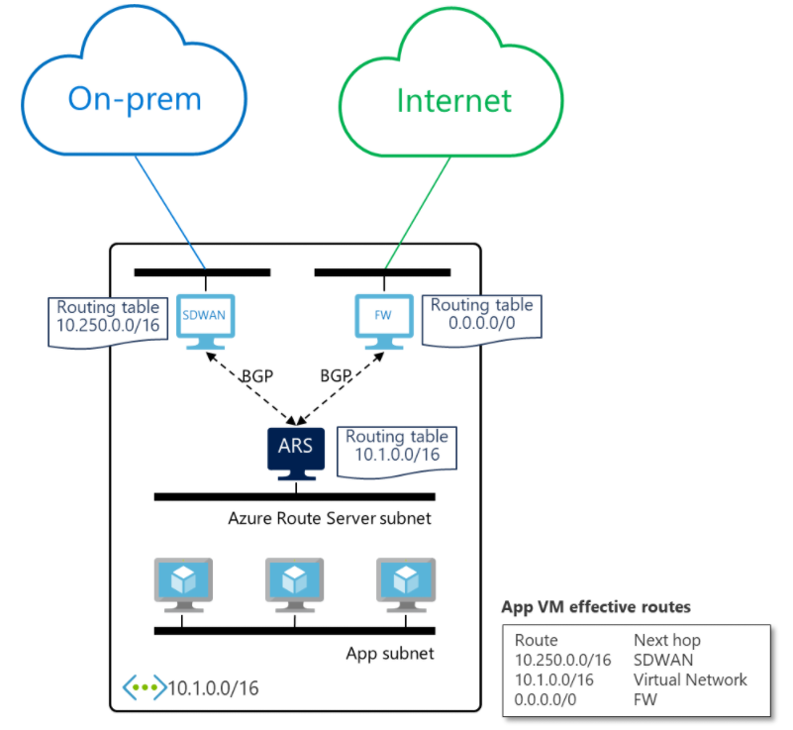
Configure Azure Route Server
Fully managed service
Simplifies dynamic routing between NVA and the VNet
NVA needs to support BGP
You no longer need to manually update the routing table on your NVA whenever your virtual network addresses are updated.
You no longer need to update User-Defined Routes manually whenever your NVA announces new routes or withdraw old ones.
Needs a RouteServerSubnet
Notes:
https://docs.microsoft.com/azure/route-server/overview

Slide 53
Diagnose a routing problem
View effective routes in the Azure portal, PowerShell or CLI
Use Azure Network Watcher to troubleshoot
Resolve Issues:
Add a custom route to override a default route.
Change or remove a custom route that causes traffic to be routed to an undesired location.
Ensure that the route table is associated to the correct subnet (the one that contains the network interface).
Ensure that devices such as Azure VPN gateway or network virtual appliances you've deployed are operating as intended.
Notes:
You can view the effective routes for each network interface by using the Azure Portal, Azure PowerShell, or Azure CLI. The following steps show examples of each technique. In each case, output is only returned if the VM is in the running state. If there are multiple network interfaces attached to the VM, you can review the effective routes for each network interface. Since each network interface can be in a different subnet, each network interface can have different effective routes.
Log into the Azure portal with an Azure account that has the necessary permissions.
In the search box, enter the name of the VM that you want to investigate.
Select the VM from the search results.
Under Settings, select Networking, and navigate to the network interface resource by selecting its name.
5. Under Support + troubleshooting, select Effective routes. The effective routes for a network interface named myVMNic1
You can view the effective routes for a network interface with the Get-AzEffectiveRouteTable command. The following example gets the effective routes for a network interface named myVMNic1, that is in a resource group named myResourceGroup:
You can view the effective routes for a network interface with the az network nic show-effective-route-table command. The following example gets the effective routes for a network interface named myVMNic1 that is in a resource group named myResourceGroup:

Slide 54
Demonstration – Custom Routing Tables
Create a route table
Add a route
Associate a route table to a subnet
Use PowerShell to view your routing information
Notes:
✔ Always consider having students walk-through the demonstrations themselves. Also, consider the overlap with the formal labs and your best use of time.
In this demonstration, we will learn how to create a route table, define a custom route, and associate the route with a subnet.
Note: This demonstration requires a virtual network with at least one subnet.
Create a routing table
Access the Azure portal.
Navigate to Route tables.
Select + Create.
Name: myRouteTablePublic
Subscription: select your subscription
Resource group: create or select a resource group
Region: select your location
Virtual network gateway route propagation: Enabled
Select Create.
Wait for the new routing table to be deployed.
Add a route
Select your new routing table, and then select Routes.
Select + Add.
Name: ToPrivateSubnet
Address prefix: 10.0.1.0/24
Next hop type: Virtual appliance
Next hop address: 10.0.2.4
Read the information and ensure you have IP forwarding enabled on your virtual appliance. You can enable this by navigating to the respective network interface's IP address settings.
Select Create.
Wait for the new route to be deployed.
Associate a route table to a subnet
Navigate to the subnet you want to associate with the routing table.
Select Route table.
Select your new routing table, myRouteTablePublic.
Save your changes.
Use PowerShell to view your routing information
Open the Cloud Shell.
View information about your new routing table.
Get-AzRouteTable
Verify the Routes and Subnet information is correct

Slide 55
Summary – Implement virtual network traffic routing
Check your knowledge
Microsoft Learn Modules (docs.microsoft.com/Learn)
Azure virtual network traffic routing | Microsoft Docs

Slide 56
Lesson 09: Configure internet access with Azure Virtual NAT

Slide 57
Configure internet access with Azure Virtual NAT overview
Azure Virtual Network NAT
Choose when to use a Virtual Network NAT
Coexistence of inbound and outbound
How to deploy NAT
Demonstration
Review
Notes:
Design and implement an Azure Virtual Network NAT
· choose when to use a Virtual Network NAT
· allocate public IP or public IP prefixes for a NAT gateway
· associate a Virtual Network NAT with a subnet

Slide 58
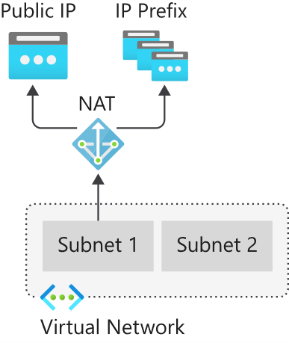
Azure Virtual NAT
Virtual Network NAT (network address translation) simplifies outbound-only Internet connectivity for virtual networks
NAT is fully managed and highly resilient. Support dynamic workloads by scaling NAT
When configured on a subnet, all outbound connectivity uses your specified static public IP addresses
Outbound connectivity is possible without load balancer or public IP addresses directly attached to virtual machines
Notes:
NAT services provide mappings for a single IP address, a range of IP addresses defined by an IP Prefix, and a range of ports associated with an IP address. NAT is compatible with standard SKU public IP address resources or public IP prefix resources or a combination of both. You can use a public IP prefix directly or distribute the public IP addresses of the prefix across multiple NAT gateway resources. NAT will map all traffic to the range of IP addresses of the prefix. NAT allows flows to be created from the virtual network to the Internet. Return traffic from the Internet is only allowed in response to an active flow.
The following diagram shows outbound traffic flow from Subnet 1 through the NAT gateway to be mapped to a Public IP address or a Public IP prefix.
You define the NAT configuration for each subnet within a VNet to enable outbound connectivity by specifying which NAT gateway resource to use. After NAT is configured, all UDP and TCP outbound flows from any virtual machine instance will use NAT for internet connectivity. No further configuration is necessary, and you don’t need to create any user-defined routes. NAT takes precedence over other outbound scenarios and replaces the default Internet destination of a subnet.

Slide 59
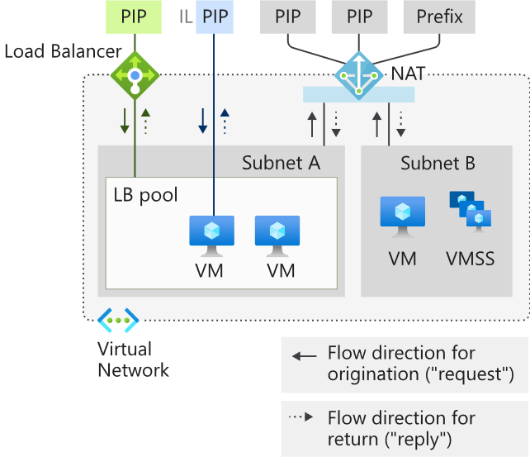
Coexistence of inbound and outbound
NAT and compatible Standard SKU features are aware of the direction the flow was started.
Inbound and outbound scenarios can coexist.
These scenarios will receive the correct network address translations because these features are aware of the flow direction.
Notes:
PIP – Public IP
IL – Instance level Public IP
VMSS – VM Scale Set
Virtual Network NAT and VM with instance-level public IP and public Load Balancer
Inbound - VM with instance-level public IP and public Load Balancer
Outbound - NAT gateway

Slide 60
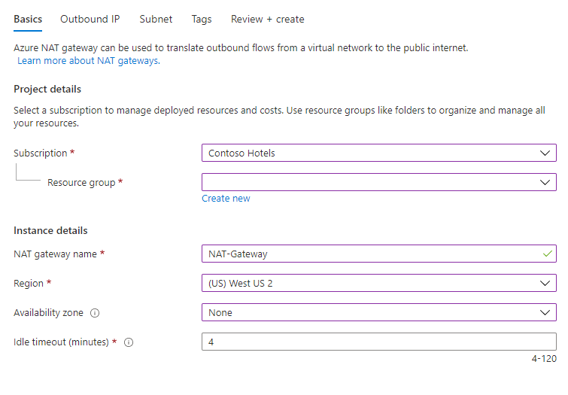
How to deploy NAT
NAT gateway resource:
Create regional or zonal (zone-isolated) NAT gateway resource
Assign IP addresses
If necessary, modify TCP idle timeout
Virtual network:
Configure virtual network subnet to use a NAT gateway.
User-defined routes are not necessary.

Slide 61
Demonstration – NAT Gateway
Create a virtual network
Create a virtual machine
Create a NAT gateway and associate with the virtual network
Connect to virtual machine and verify NAT IP address
Notes:
Tutorial: Create a NAT gateway - Azure portal | Microsoft Docs
https://docs.microsoft.com/azure/virtual-network/nat-gateway/tutorial-create-nat-gateway-portal
Create a virtual network.
Create a virtual machine.
Create a NAT gateway and associate with the virtual network.
Connect to virtual machine and verify NAT IP address.

Slide 62
Summary – Azure virtual Network NAT
Check your knowledge
Microsoft Learn Modules (docs.microsoft.com/Learn)
What is Azure Virtual Network NAT? | Microsoft Docs
Designing Virtual networks with NAT gateway resources - Azure Virtual Network NAT | Microsoft Docs

Slide 63
End of presentation

